Slide 1

STADIUM VISITOR’S EXPERIENCE APP

Slide 2
TEAM MEMBER’S :
1
2
4
T NITHIN
SANJAY J
3
NAGARAJ LONI
SANJAY D

Slide 3
ABSTRACT
The Project implements Stadium Visitor’s Experience App Using Python.
It’s Developed using Object-Oriented-Programming and CRUD operations.
It Allows for the Creating, Reading, Updating and Deleting operations on Stadium visitors, services and store the visitors details using JSON file as Database.
Unit test are included to ensure the functionality of the system and with the help of File handling it generates a report.

Slide 4
INTRODUCTION
This Project aims to provide the Services to the Stadium visitors.
Classes representing different entities of the project (‘Visitor’ and ‘Visit’).
Implementation of CRUD operations for managing visitor data.
Functions to enhance visitor experiences and offer real-time support.
Enhancing stadium visits by offering targeted services.
Providing real-time support and information to visitors.

Slide 5
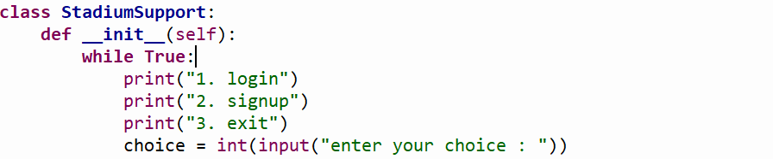
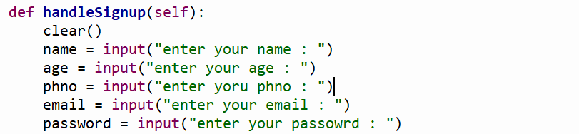
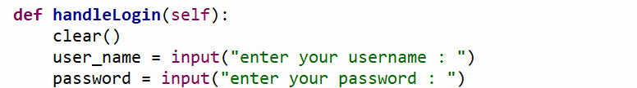
MODULE DESCRIPTION

Slide 6
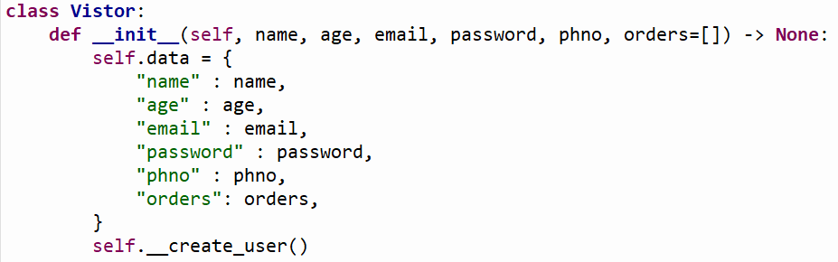
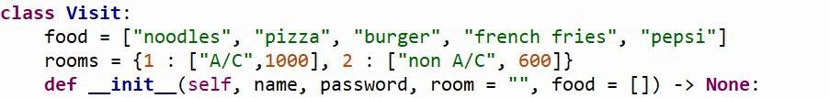

Slide 7
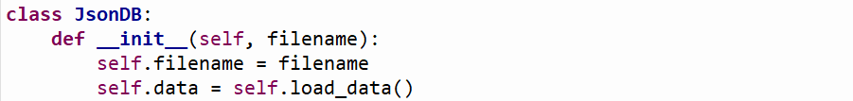






Slide 8
CODE DESCRIPTION
Stadium Support System : This module provides a command-line interface for a stadium support system. It allows users to login, signup, and manage their visits to the stadium. The system provides features such as ordering food, booking rooms, updating user details, and deleting visit records. The module uses a JSON database to store user and visit data and provides a simple text-based interface for users to interact with the system.
Visitor Management : This module provides a Visitor class that manages visitor data for a stadium or event. The class allows visitors to create an account, update their details, and delete their account. The module uses a JSON database to store visitor data and provides methods to create, read, update, and delete visitor records. The Visitor class also includes features such as updating orders and retrieving visitor details.
Visit Management : This module provides a class Visit that manages visits to a hotel or resort. It allows users to create a visit, book a room, order food, and save their visit details. The module uses a JSON database to store visit data and provides methods to create, read, update, and delete visit records. The Visit class also includes features such as suggesting food items based on previous orders and validating user credentials.

Slide 9
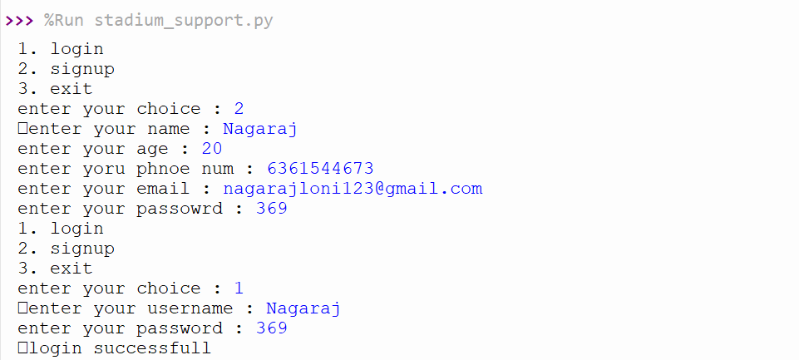
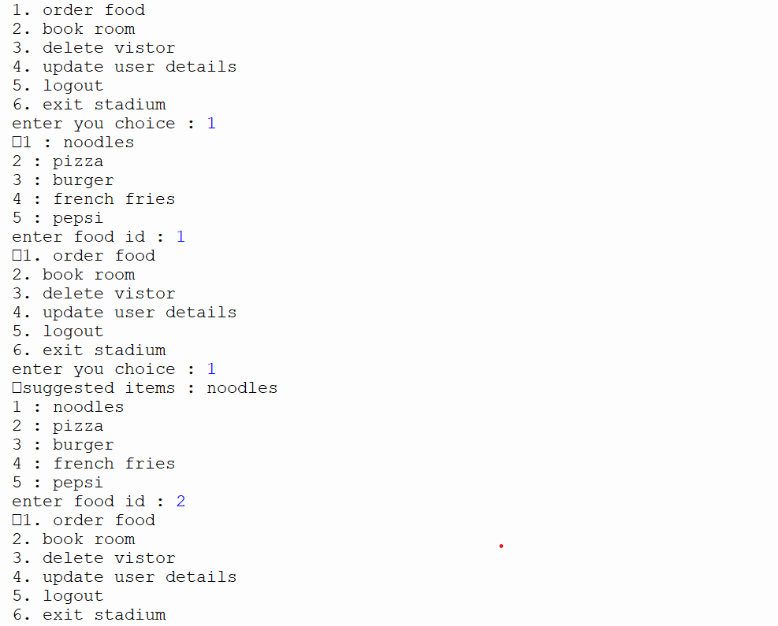

Slide 10
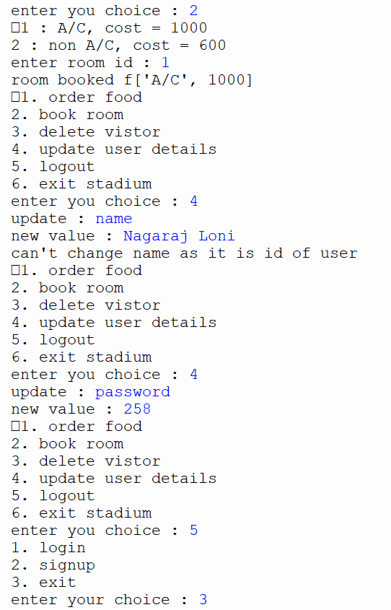
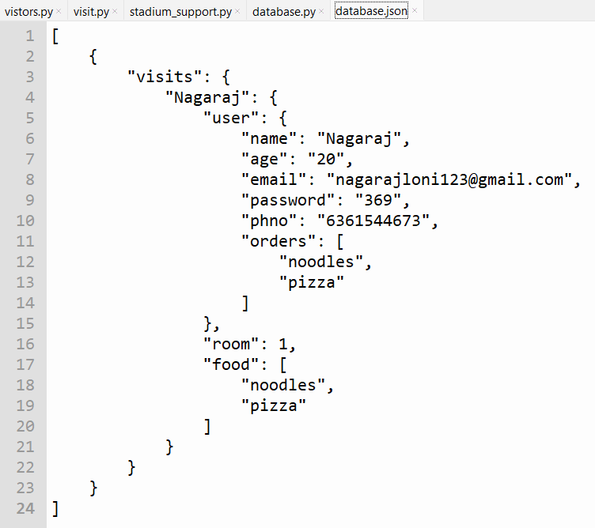

Slide 11
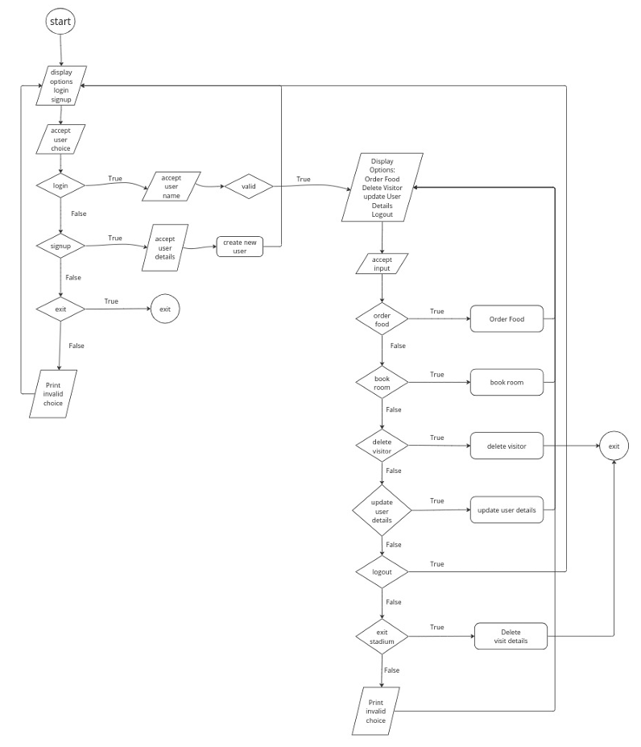
FLOW CHART

Slide 12

REFERENCES
Google Chrome
https://github.com/Nsloni
https://github.com/NITHIN-85
w3resource
https://github.com/sanjayJ369
https://github.com/Sanjaydevale

Slide 13
THANK YOU

